Slide 1
Usability Heuristics & GUI Proposal
By Vignesh
Notes:
After analysing the previous batch’s prototype for their conformance to usability heuristics, I extrapolated the following findings.

Slide 2
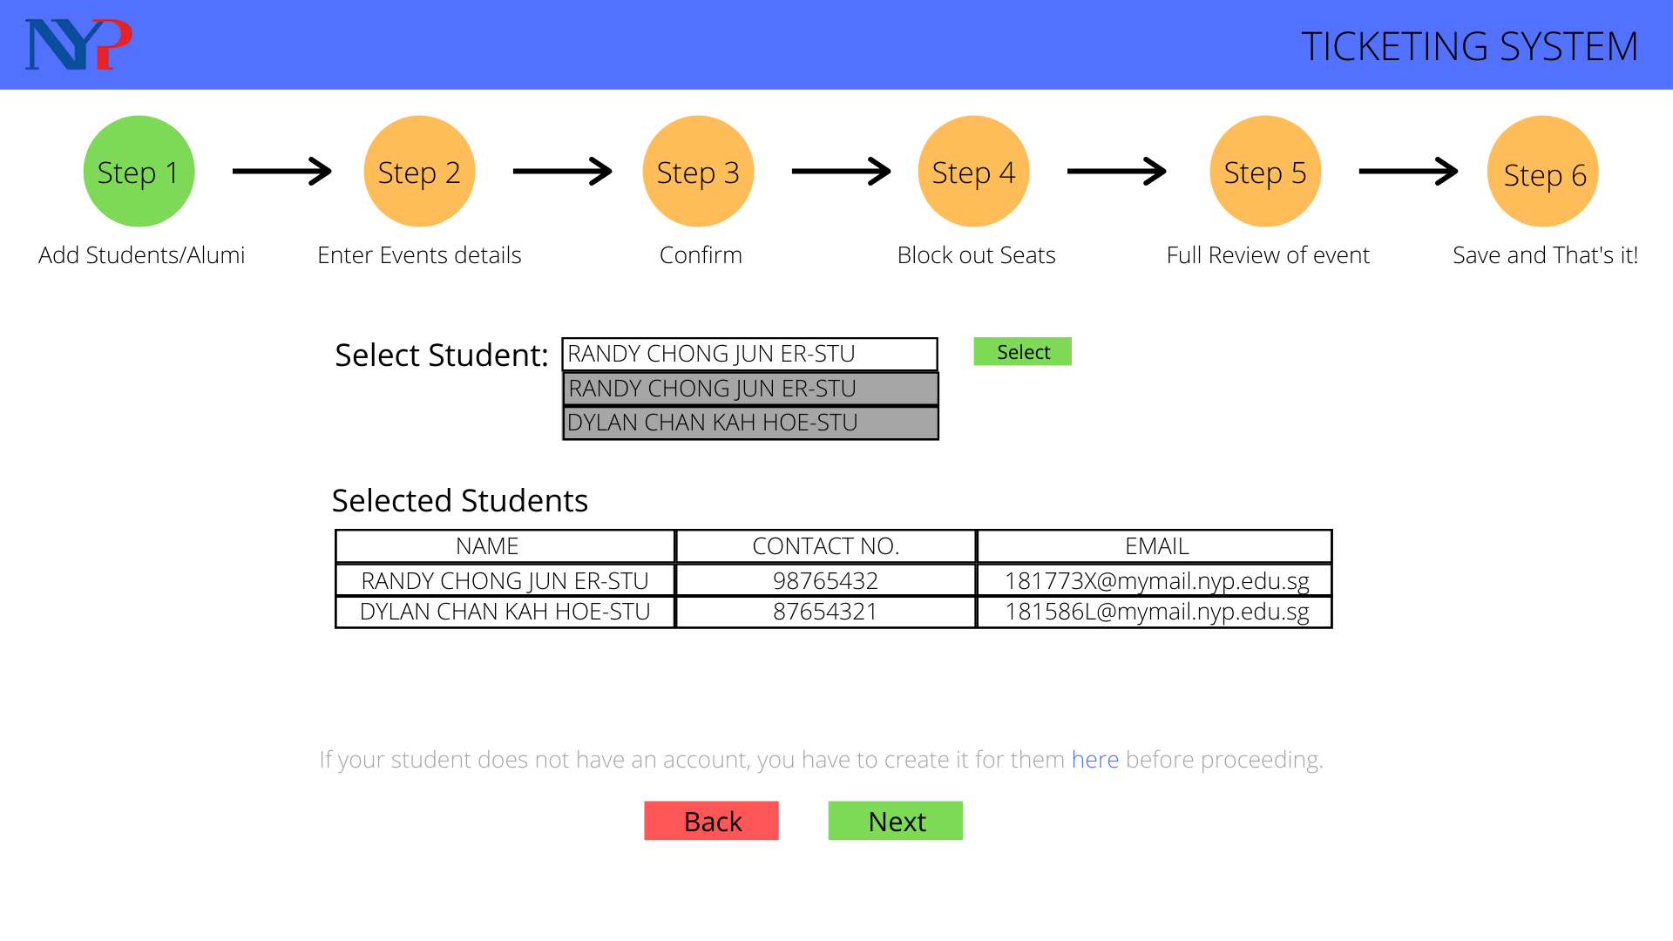
The Good!
Conforms to some usability heuristics like visibility of system status!
Notes:
Some parts of the project show a good understanding of usability heuristics.
For example, this form flow diagram keeps the user informed of their progress through a multipage form, which conforms to one of the most important usability heuristics, the visibility of the system status.

Slide 3
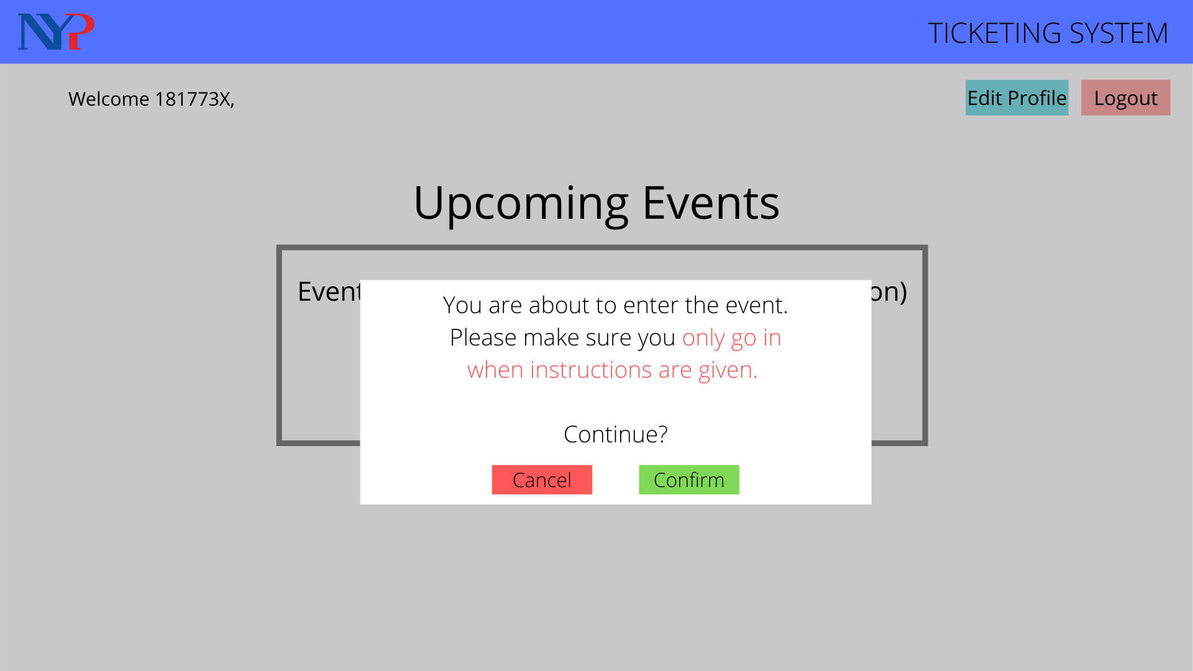
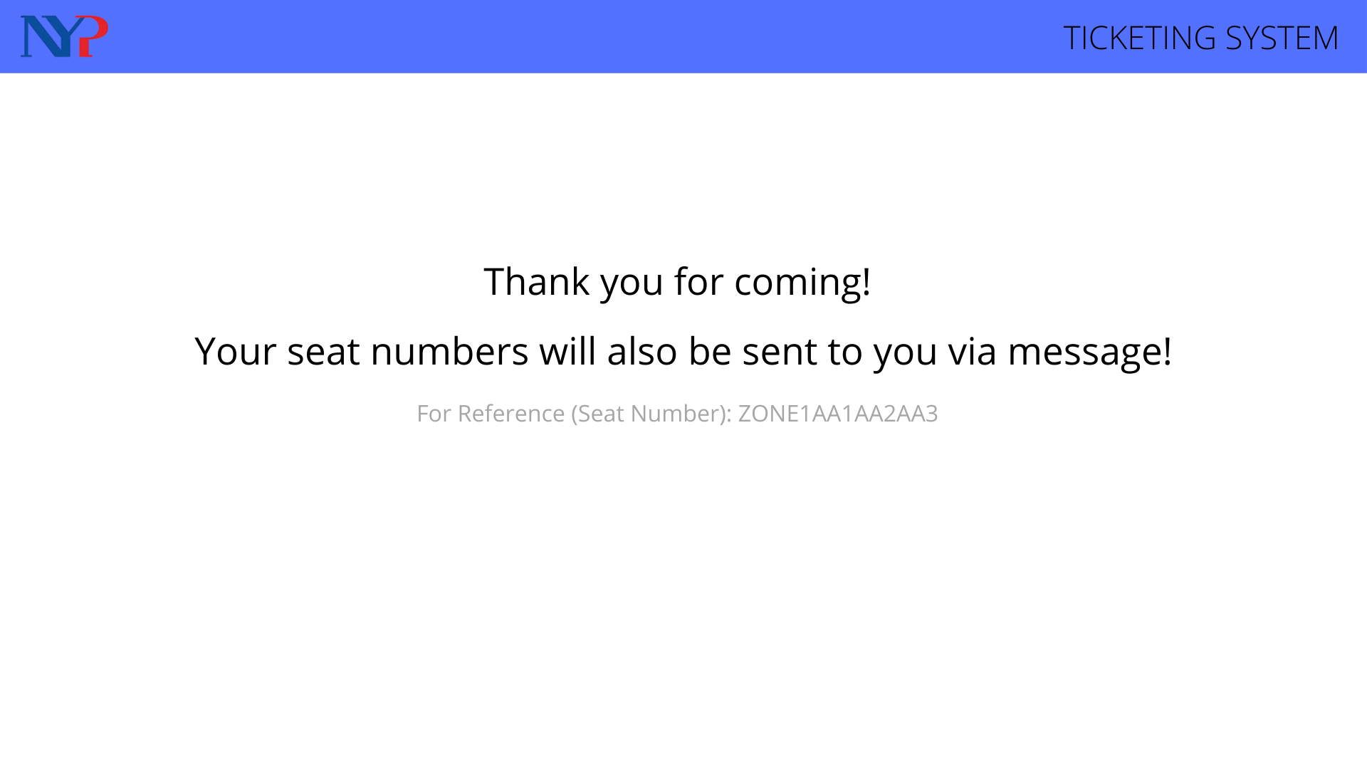
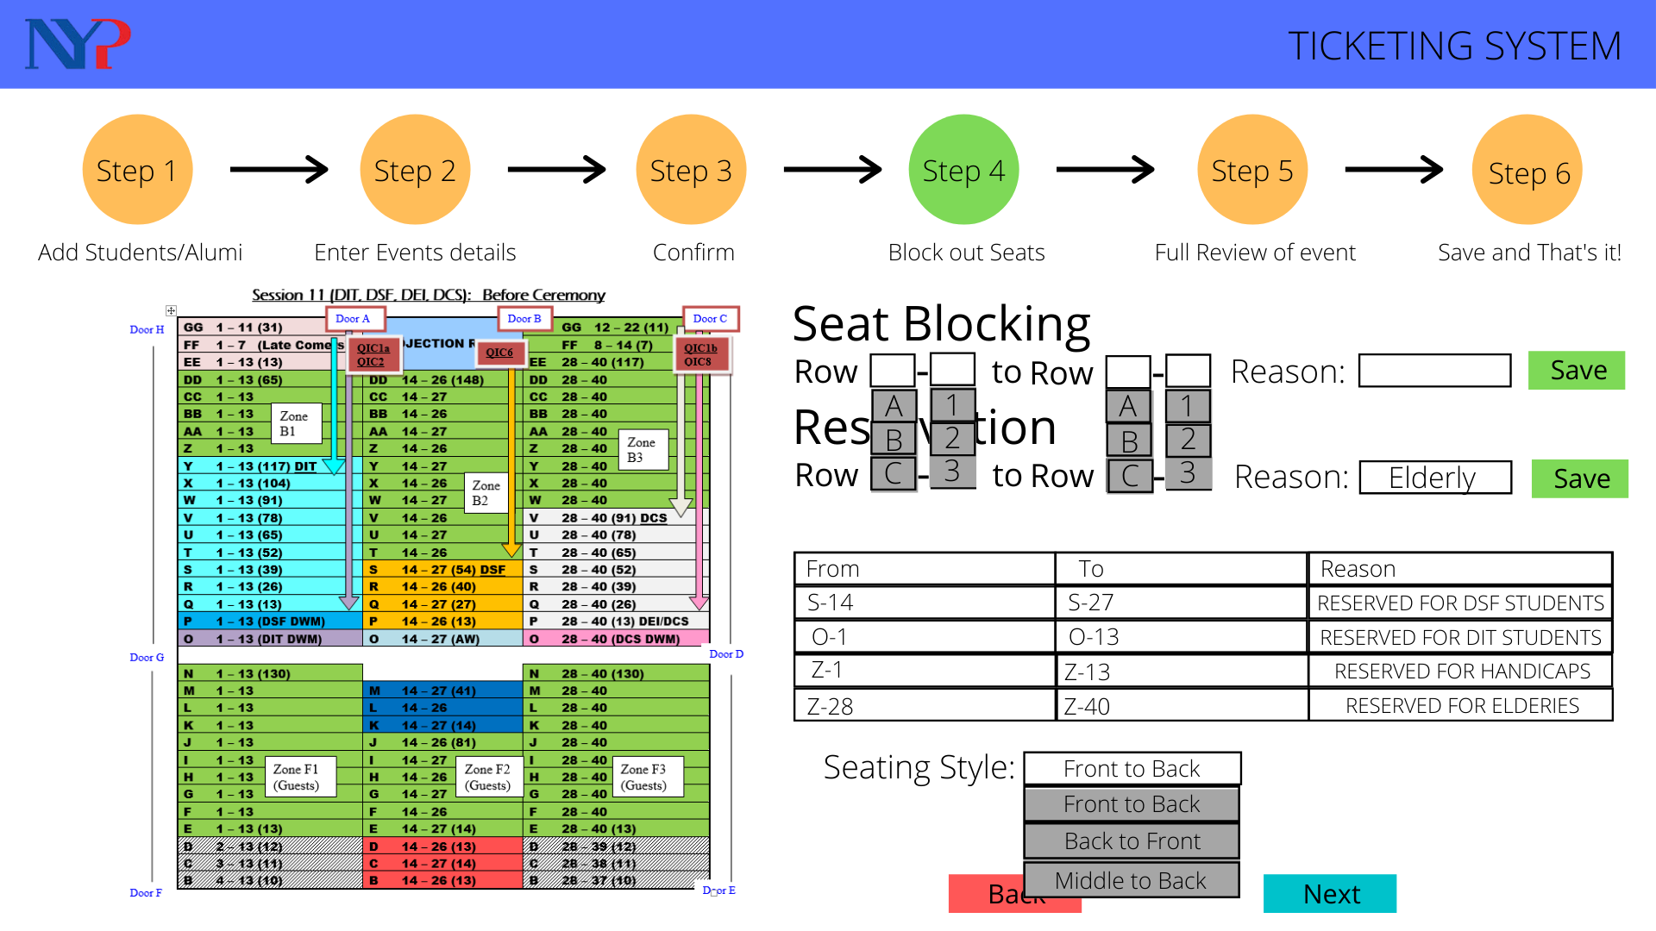
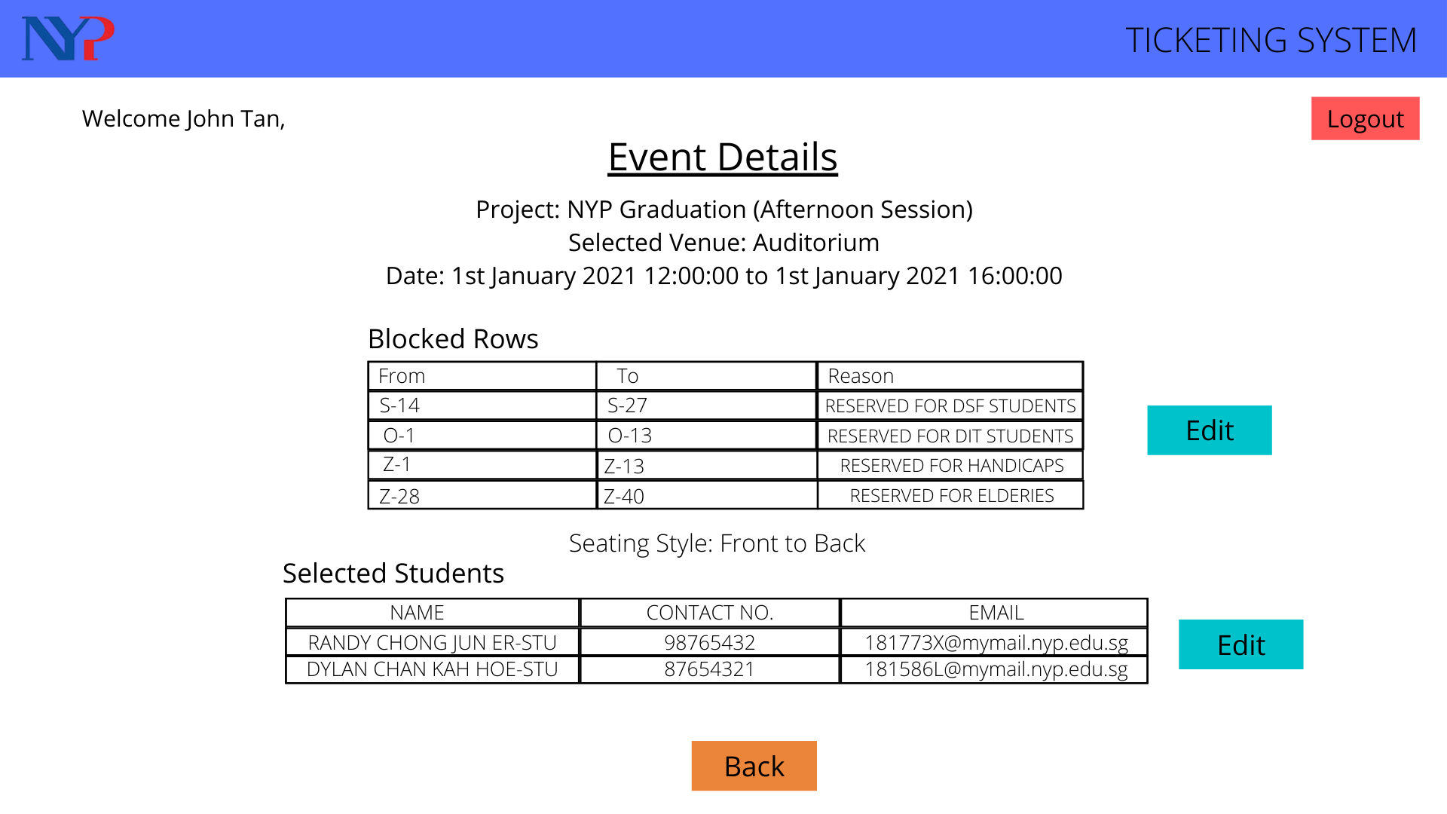
The Bad.
Inconsistent Wording
Redundant Information
Confusing System-Oriented Language
Notes:
However, the app falters by having inconsistent wording and presenting redundant information in a system-oriented language that might cause unnecessary confusion in the average user.

Slide 4
The Ugly…
Application is primarily used by
Inexperienced students
Working under a high pressure environment
Confusion -> Holding up lines -> Growing tensions -> Conflict
Ease of use is of the utmost importance!
Notes:
This especially matters in an application that’s going to be primarily used by relatively inexperienced students working under high pressure.
Any little confusion with the system could mean holding up the line for people who will be growing increasingly impatient. This can build up tensions between students and attendees which could ultimately lead to conflict.
Thus, my primary goal with the GUI proposal was to make the website easier to parse and use while expanding on some of the features left unfinished by the previous batch.

Slide 5
GUI Proposal
Notes:
With that I’ll now present my GUI proposal.

Slide 6
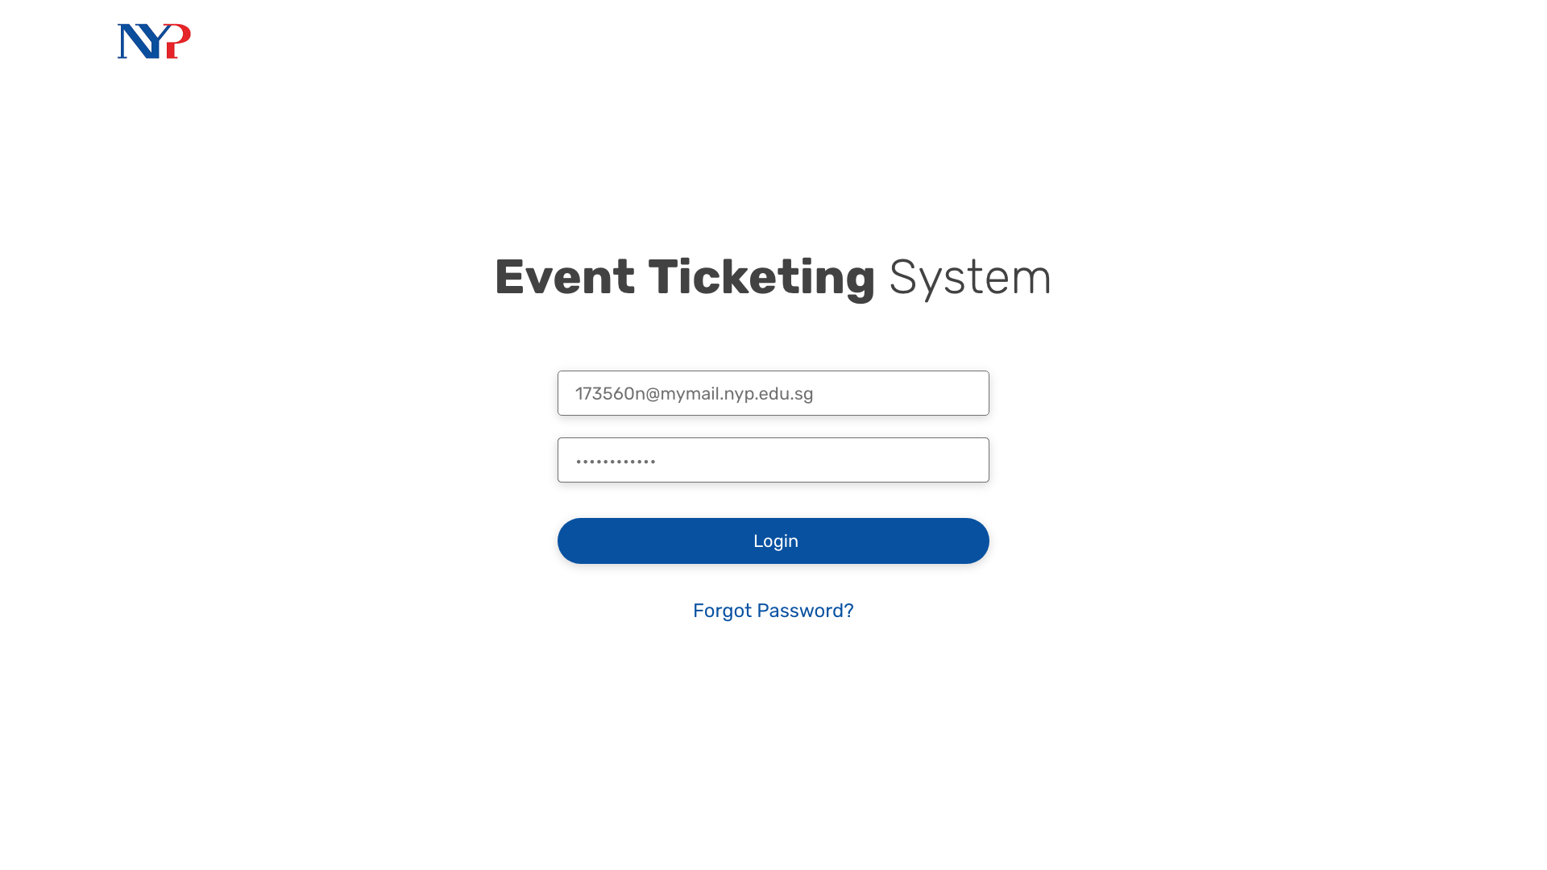
Notes:
We start with the login screen (nothing remarkable)
We might not even have a login screen depending on whether Oauth might work for our project
Anyway, a student will now login to the system.

Slide 7
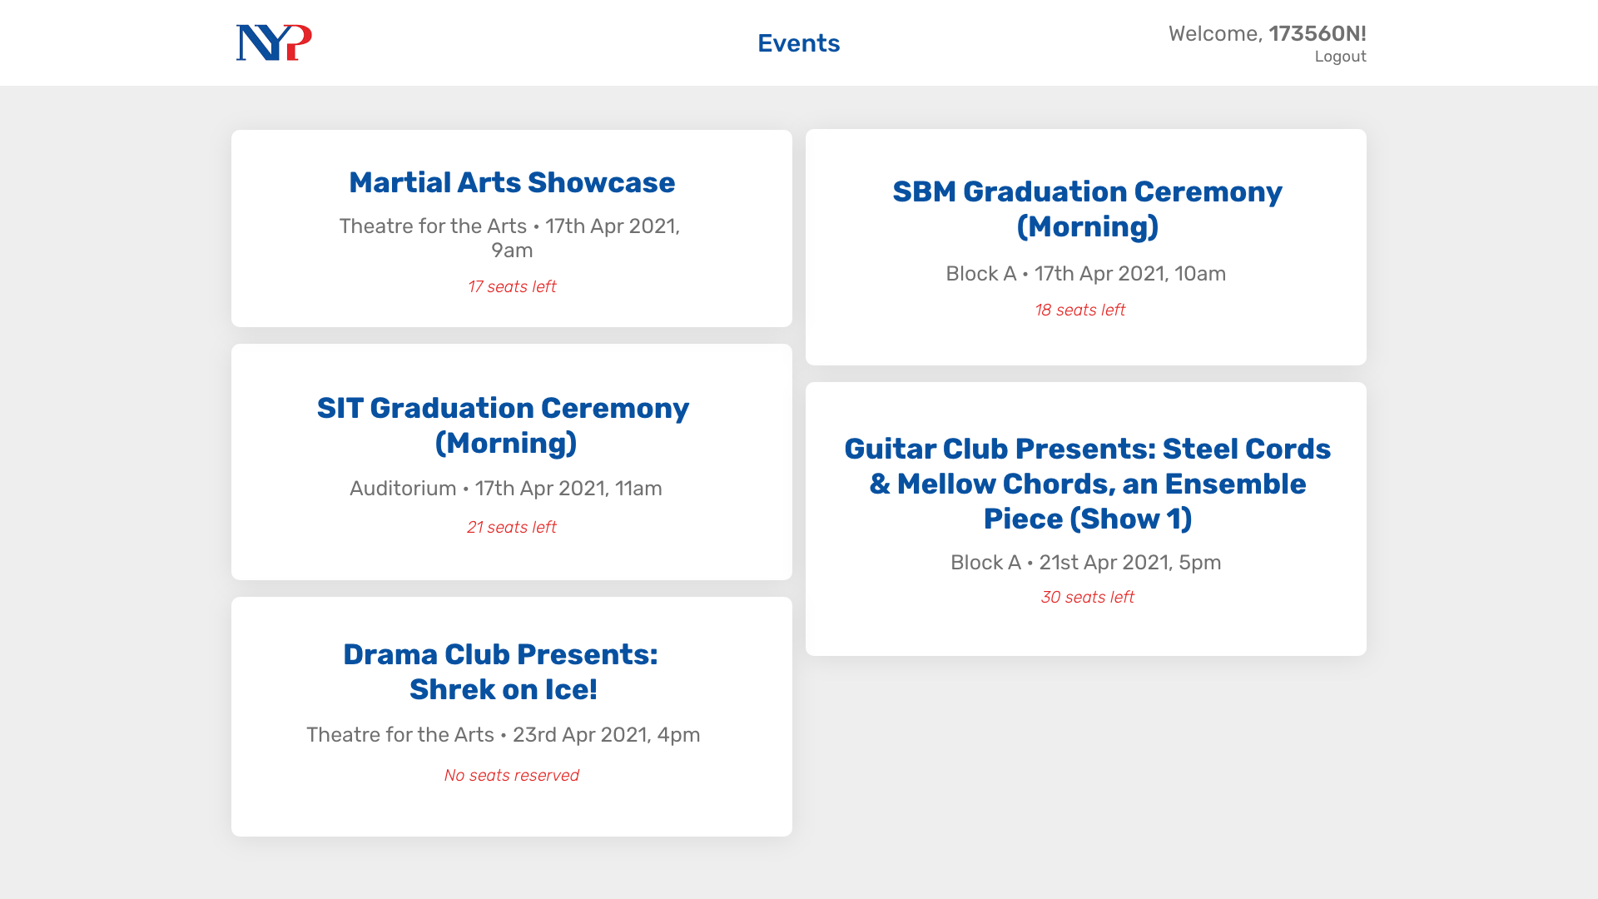
Notes:
Upon entering, they’re presented with this screen where they can view events they are helping with in a more visually appealing manner.
Once they click on one of these event cards, they can view more details.

Slide 8
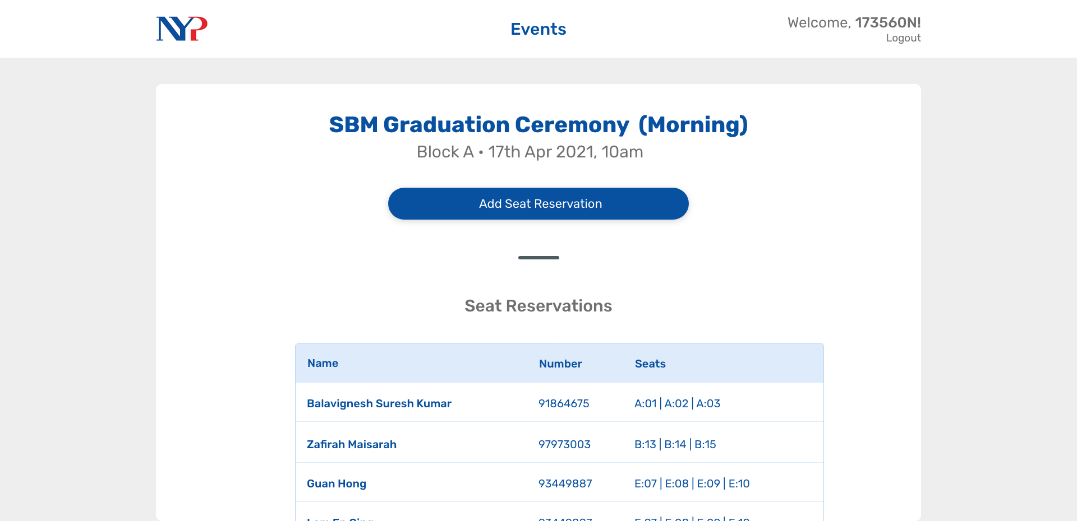
Notes:
So here, they can see the seats that are already reserved in a table form.
They can then choose to reserve a new set of seats by pressing the button.

Slide 9
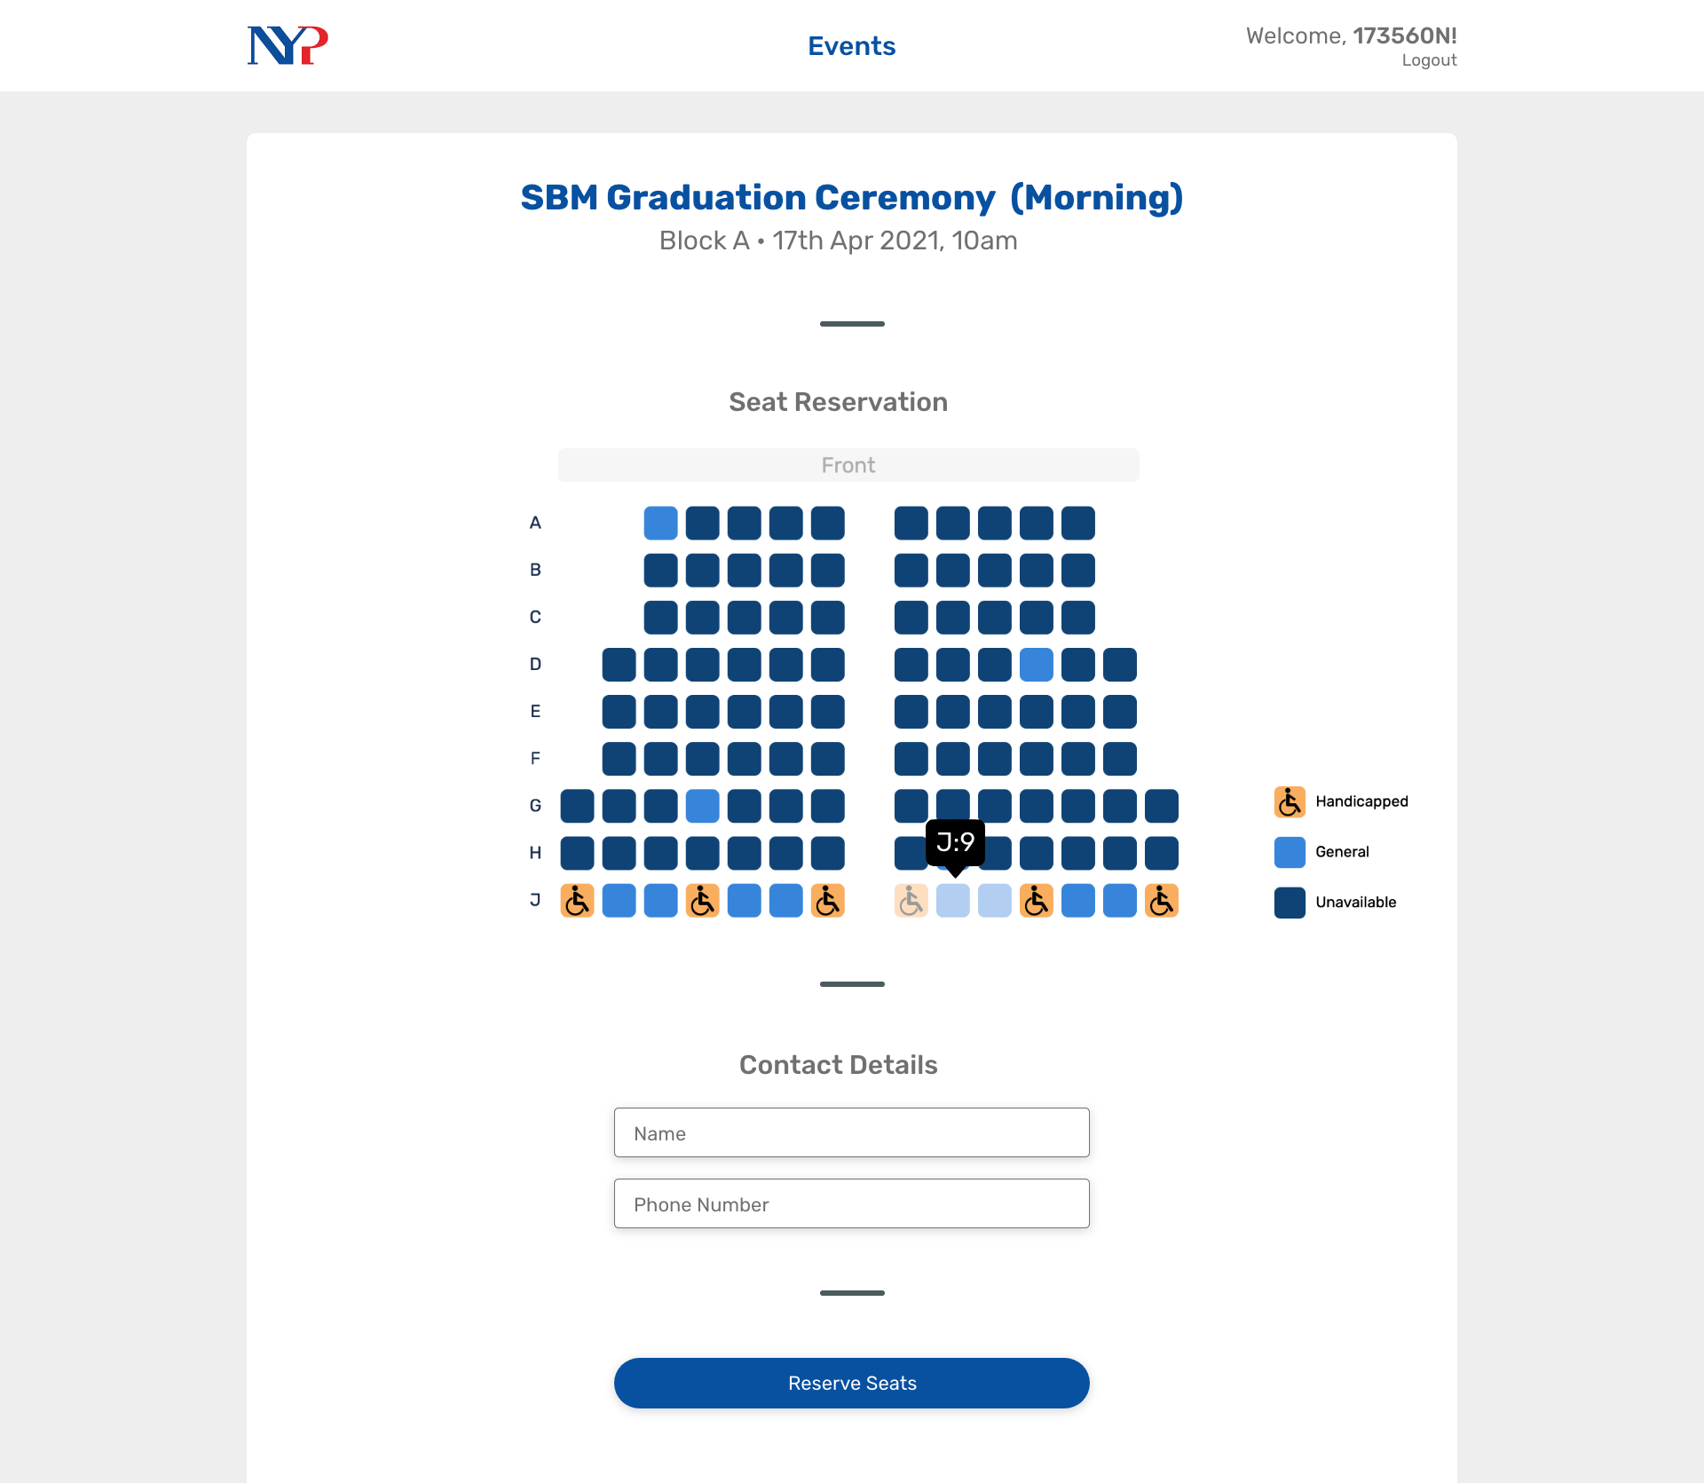
Notes:
over here, i'm using a functional seat chart to show the student helper all the seats that are available in a more visual manner. they can then select the seats they deem fit for the attendees.
after doing so they just have to enter the contact details to send them their tickets via SMS
warn student helper when not booking seats according to criteria (top -> down)
block seats at event creation
able to change handicapped seats for each event
add more validation

Slide 10
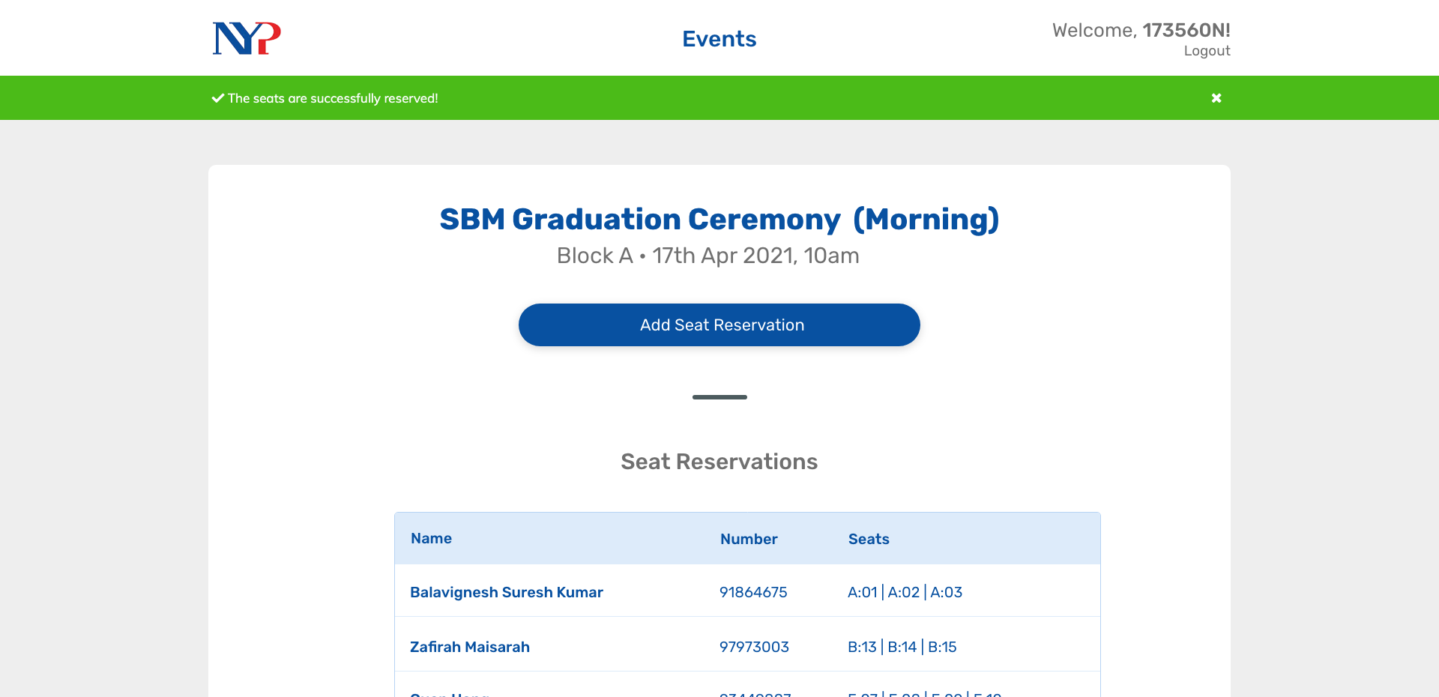
Notes:
And after this process is done, they

Slide 11
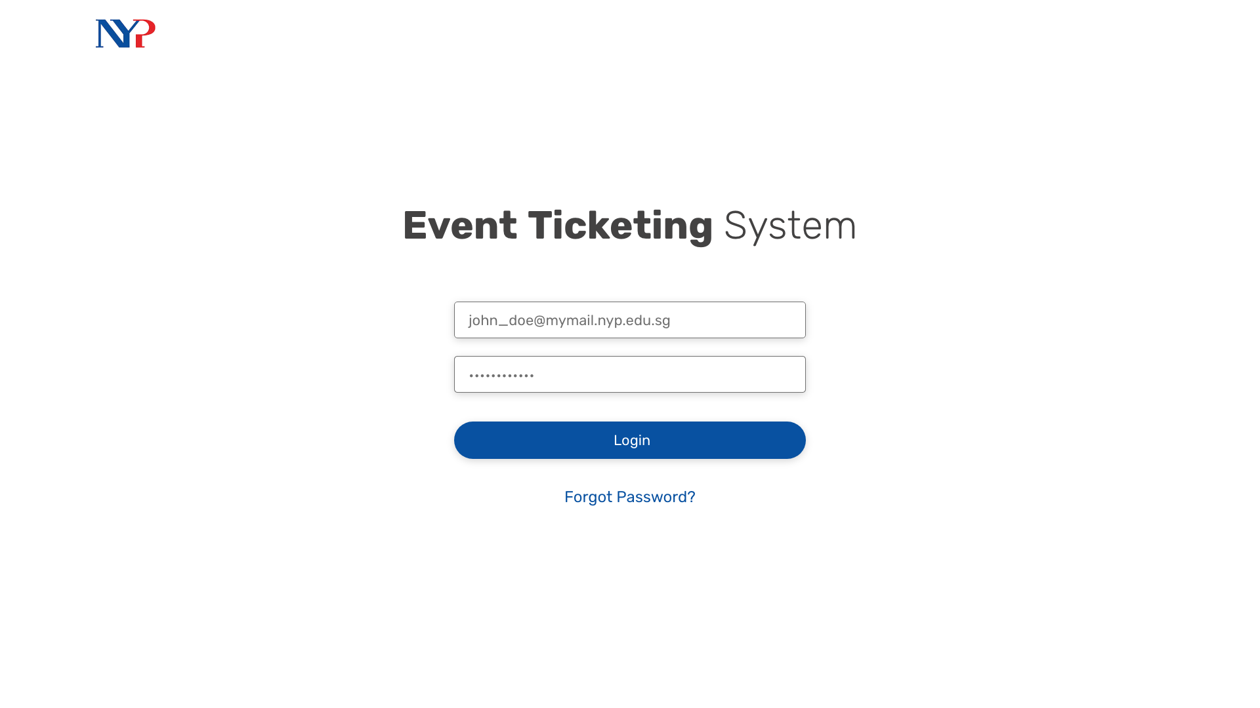

Slide 12
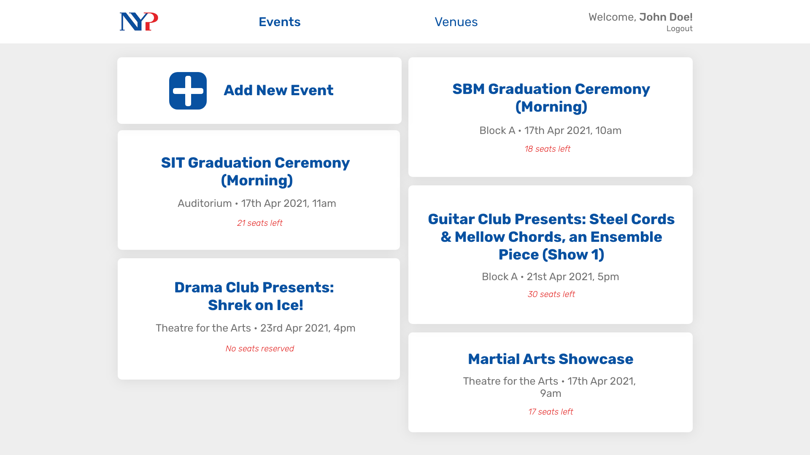

Slide 13
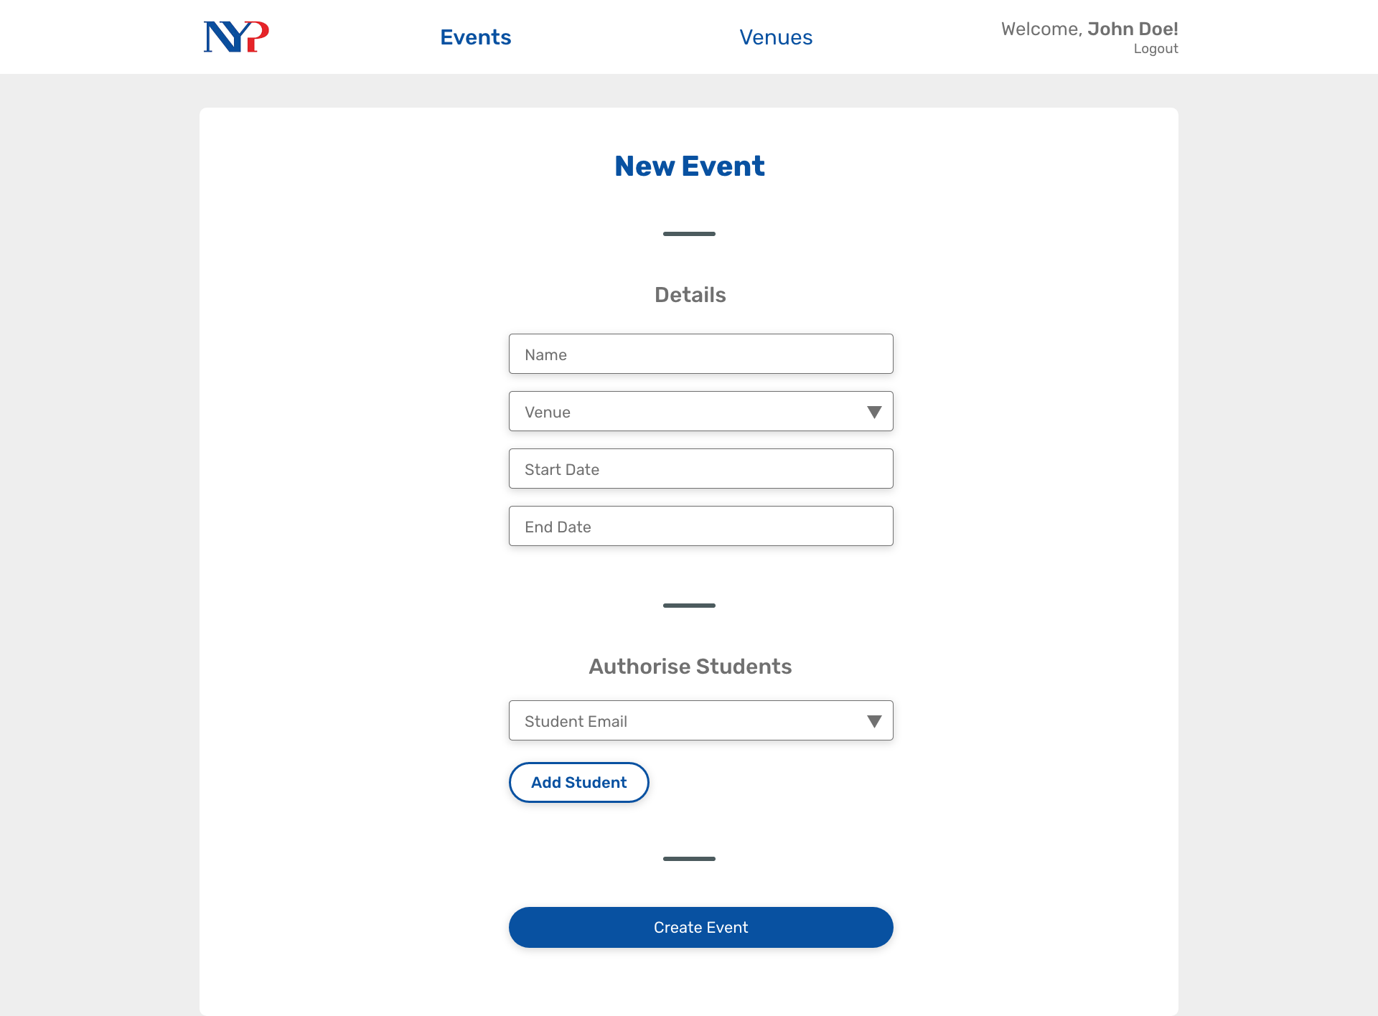

Slide 14
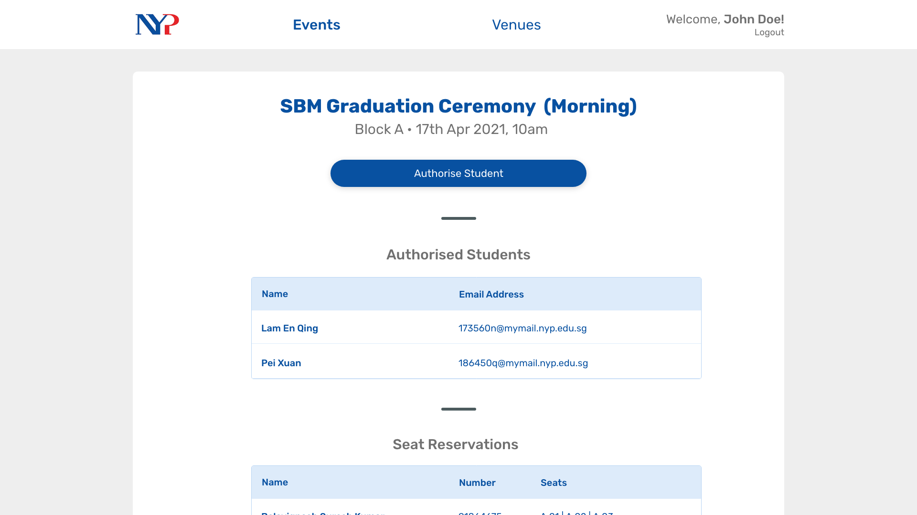

Slide 15
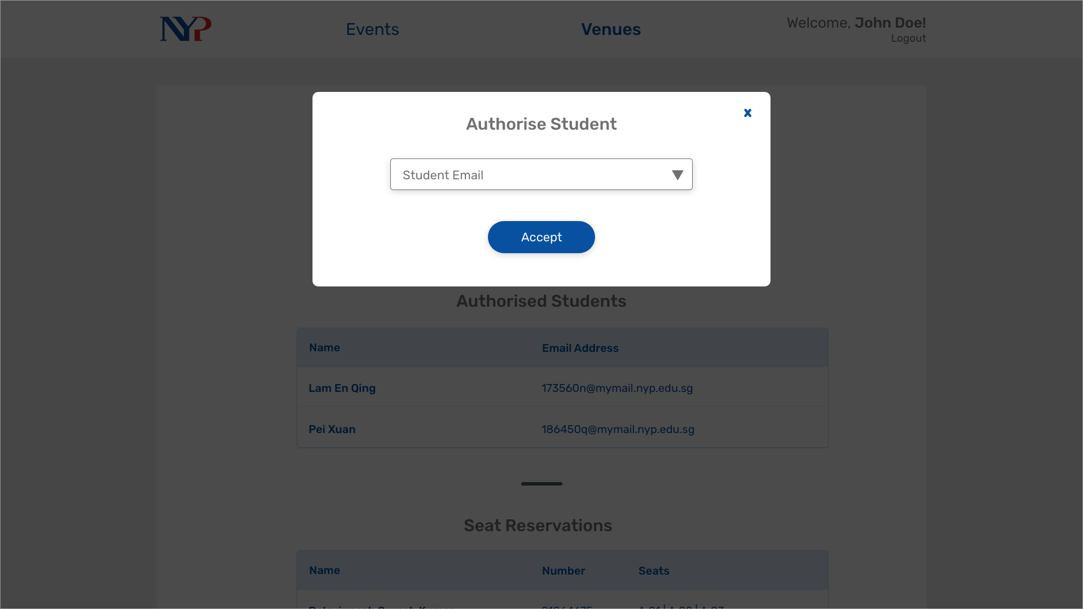

Slide 16
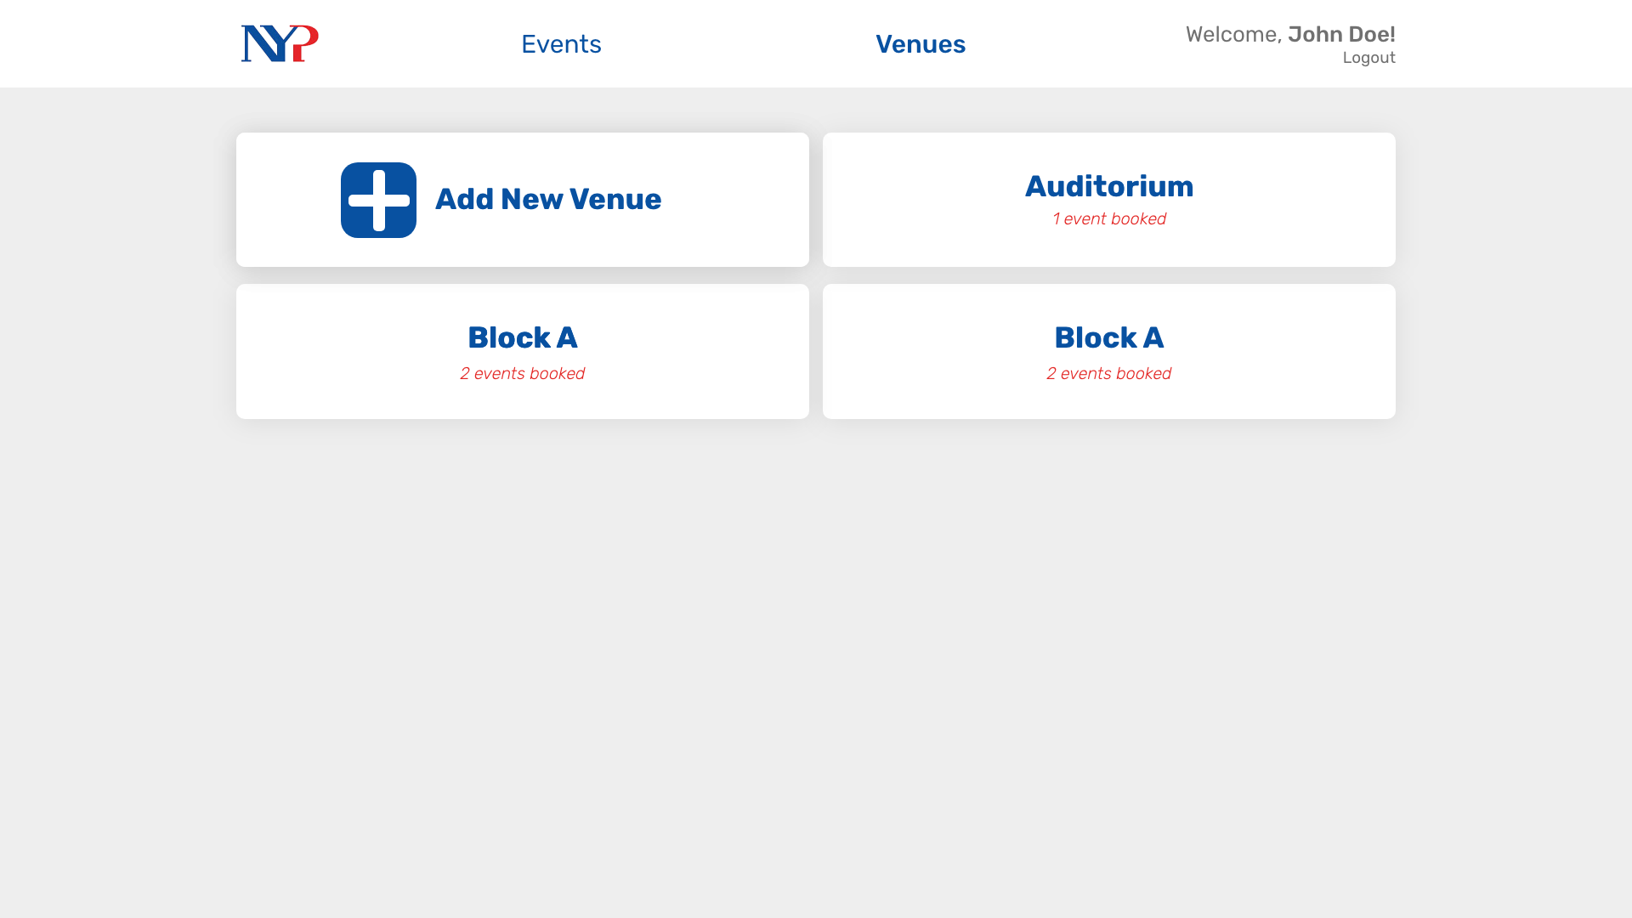

Slide 17
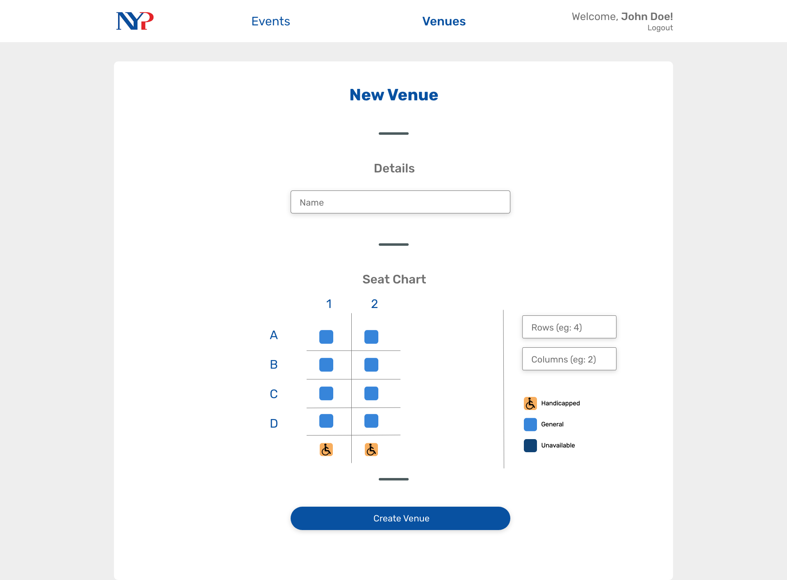

Slide 18
Thank you!

